Slide 1
UMD DATA605 - Big Data Systems NoSQL key-value stores (Apache) Cassandra
(Apache) HBase
GP Saggese
gsaggese@umd.edu
with thanks to:
Alan Sussman (UMD)
Amol Deshpande (UMD) Oliver Kennedy (U. Buffalo)
Doug Thain (U. Notre Dame)

Slide 2
UMD DATA605 - Big Data Systems NoSQL key-value stores Cassandra
HBase

Slide 3
NoSQL Stores
Geared toward the use case of large-scale web applications that need real-time access
With a few ms latencies (e.g., Facebook == 4ms for reads)
To solve problems with using relational databases
Too slow
Don't need ACID properties, or at least full-blown transactions
Too expensive (monetary cost)

Slide 4
Some Interesting Stats
Interesting numbers from a few years ago (http://highscalability.com)
Twitter: 177M tweets sent on 3/1/2011 (nothing special about the date), 572,000 accounts added on 3/12/2011
Dropbox: 1M files saved every 15 mins
Stackoverflow: 560M page views per month (Redis for caching)
Wordnik: 10 million API Requests a Day on MongoDB and Scala – dictionary and language resource
Mollom: Killing Over 373 Million Spams at 100 Requests Per Second (Cassandra)
Facebook's New Real-time Messaging System: HBase to Store 135+ Billion Messages a Month
Interestingly: decided to move away from Cassandra because not happy with the eventual consistency model
Reddit: 270 Million Page Views a Month in May 2010 (Memcached)

Slide 5
Key Challenge 1: Guaranteeing consistency in a distributed environment
Need replication for availability, performance, and fault-tolerance
How to update them simultaneously?
2-Phase Commit: Original proposal for doing this
Can't handle master failure
Paxos: More widely used today
doesn't require a master so more fault tolerant
Either of them is too expensive in general
Many systems use relaxed/loose consistency models

Slide 6
Key Challenge 1
Eventual consistency was popularized by Amazon DynamoDB
Guarantees provided only on the eventual outcome
Cannot provide guarantees about what different clients will see, in which order they will see updates etc.
Quorums
Let N be the total number of replicas
When writing, we make sure to write to W replicas
When reading, we read from R replicas and pick the latest (using timestamps, or vector clocks)
If W + R > N and W + W > N, we have a fully consistent system
So the system wouldn't be available if there is a network partition
For other values of W and R, we end up with looser guarantees

Slide 7
Key Challenge 1
CAP theorem: can have two of: consistency, availability, and tolerance to network partitions
Originally a conjecture (Eric Brewer), but made formal later (Gilbert, Lynch, 2002)
Theorem: It is impossible in the asynchronous network model to implement a read/write data object that guarantees the following properties:
Availability
Atomic consistency in all fair executions (including those in which messages are lost)
In other words, if there is a network partition, we can:
Go down (sacrifice availability), or
Allow inconsistency

Slide 8
Key Challenge 2: Performance and Scale
Must give up something if you want to really scale
Give up Consistency (as discussed earlier)
Give up Joins
Most NoSQL stores don't allow joins
Instead require data to be denormalized and duplicated
Only allow very restricted transactions
Most NoSQL stores will only allow one object transactions (e.g., one document, or one key)

Slide 9
Denormalization
We discuss MongoDB notes (http://docs.mongodb.org/manual/core/data-modeling-introduction/) on this topic
Denormalization can be used to avoid joins, but usually at the cost of duplication, which opens up the potential for anomalies when the duplicated information is not kept in sync

Slide 10
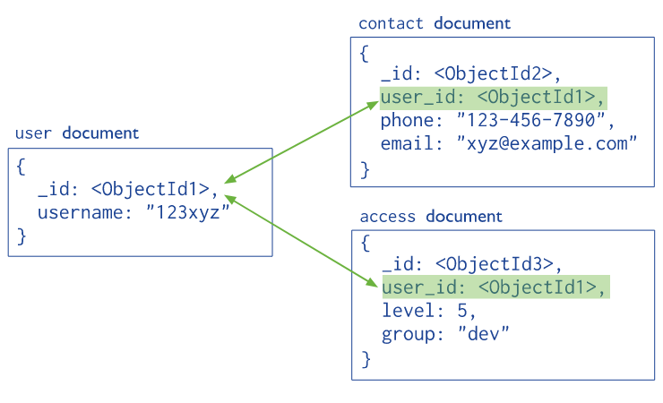
Normalized Data Models
Normalized data models describe relationships using references between documents.
From MongoDB manual

Slide 11
Normalized Data Models
According to MongoDB designers, use normalized data models:
when embedding (using references) would result in duplication of data but would not provide sufficient read performance advantages to outweigh the implications of the duplication.
to represent more complex many-to-many relationships.
to model large hierarchical data sets.
References provides more flexibility than embedding
However, client-side applications must issue follow-up queries to resolve the references
So normalized data models can require more round trips to the server.
From MongoDB manual

Slide 12
Embedded (Denormalized) Data Models
Allow applications to store related pieces of information in the same database record
So applications may need to issue fewer queries and updates to complete common operations
Use embedded data models when:
you have “contains” relationships between entities. See Model One-to-One Relationships with Embedded Documents.
you have one-to-many relationships between entities. In these relationships the “many” or child documents always appear with or are viewed in the context of the “one” or parent documents. See Model One-to-Many Relationships with Embedded Documents.
Embedding provides better performance for read operations, as well as the ability to request and retrieve related data in a single database operation.
Embedded data models make it possible to update related data in a single atomic write operation.
From MongoDB manual

Slide 13
Key differentiators between NoSQL Stores
Data Model: Key-value, Wide-column, Document (JSON), Property Graph
Underlying architecture (e.g., Cassandra uses a P2P-style architecture underneath)
Replication scheme
Querying functionality
Cassandra has minimal query language, whereas MongoDB query language is much more functional and support aggregations and map-reduce
CAP
Cassandra supports tunable consistency
HBase gives up availability
See http://blog.nahurst.com/visual-guide-to-nosql-systems for other systems and a longer discussion

Slide 14
Key differentiators - CAP
By data model:
Relational systems are the databases we've been using for a long time. RDBMSs and systems that support ACID properties and joins are considered relational
Key-value systems basically support get, put, and delete operations based on a primary key
Column-oriented systems still use tables but have no joins (joins must be handled within your application). They store data by column as opposed to traditional row-oriented databases. This makes aggregations much easier.
Document-oriented systems store structured "documents" such as JSON or XML but have no joins (joins must be handled within your application). It's very easy to map data from object-oriented software to these systems.

Slide 15
Consistent, Available (CA) Systems
Have trouble with partitions and typically deal with it with replication
Examples include:
Traditional RDBMSs like PostgreSQL, MySQL, etc. (relational)
Vertica (column-oriented)
Aster Data (relational)
Greenplum (relational)

Slide 16
Consistent, Partition-Tolerant (CP) Systems
Have trouble with availability while keeping data consistent across partitioned nodes
Examples include:
BigTable (column-oriented/tabular)
Hypertable (column-oriented/tabular)
HBase (column-oriented/tabular)
MongoDB (document-oriented)
Terrastore (document-oriented)
Redis (key-value)
Scalaris (key-value)
MemcacheDB (key-value)
Berkeley DB (key-value)

Slide 17
Available, Partition-Tolerant (AP) Systems
Achieve "eventual consistency" through replication and verification
Examples include:
Dynamo (key-value)
Voldemort (key-value)
Tokyo Cabinet (key-value)
KAI (key-value)
Cassandra (column-oriented/tabular)
CouchDB (document-oriented)
SimpleDB (document-oriented)
Riak (document-oriented)

Slide 18
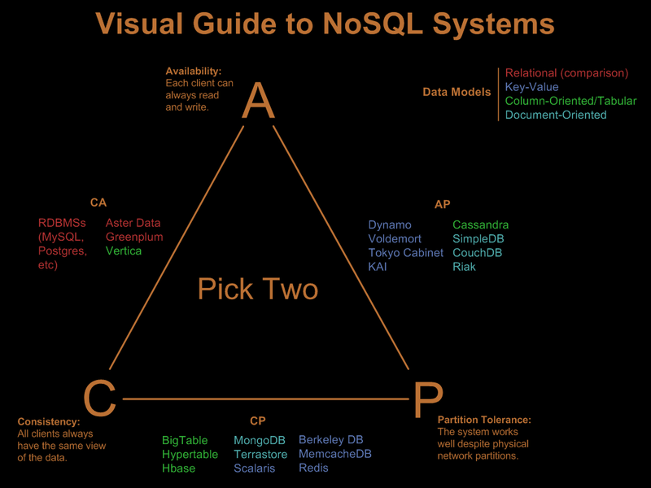
Overall CAP picture
From Nathan Hurst’s blog - http://blog.nahurst.com/visual-guide-to-nosql-systems

Slide 19
UMD DATA605 - Big Data Systems NoSQL systems
Key-value stores Cassandra
HBase

Slide 20
(Apache) Cassandra
Started as a project at Facebook
First published in 2010 ACM SIGOPS OS Review
“A distributed storage system for managing very large amounts of structured data spread out across many commodity servers”
Extension of Google BigTable with aspects of Amazon Dynamo
Motivations:
High availability
High Write throughput
Fault tolerance
Supports “eventual consistency” across replicas, with some tunable parameters (e.g., number replicas, number read copies vs. write copies)

Slide 21
Data Model
Table is a multi-dimensional map indexed by key (row key)
Columns are grouped into Column Families.
2 Types of Column Families
Simple
Super (nested Column Families)
Each Column has
Name
Value
Timestamp

Slide 22
Data Model
keyspace
settings
column family
settings
column
name
value
timestamp
* Figure taken from Eben Hewitt’s (author of Oreilly’s Cassandra book) slides.

Slide 23
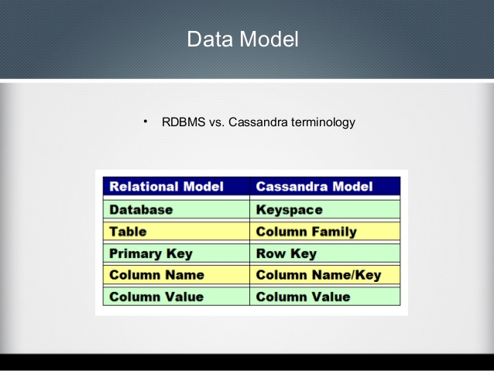
From www.slideshare.net, Oleg Magazov

Slide 24
Queries
Cassandra Query Language
Very similar to SQL – data is put into tables that contain rows of columns
All details at http://cassandra.apache.org/doc/latest/cql/index.html
Real difference of Cassandra from RDBMS is performance on very large datasets – comes from column-oriented structure, and scalability (and no transactions)

Slide 25
Example Queries
SELECT name AS user_name, occupation AS user_occupation FROM users;
SELECT time, value
FROM events
WHERE event_type = 'myEvent’
AND time > '2011-02-03’
AND time <= '2012-01-01’;
SELECT COUNT (*) AS user_count FROM users;

Slide 26
System Architecture
Partitioning
How data is partitioned across nodes
Replication
How data is duplicated across nodes
Cluster Membership
How nodes are added, deleted to the cluster
Overall, it’s a peer-to-peer (P2P) architecture for distributed data storage

Slide 27
Partitioning
Nodes are logically structured in Ring Topology.
Hashed value of key associated with data partition is used to assign it to a node in the ring.
Hashing rounds off after certain value to support ring structure.
Lightly loaded nodes moves position to alleviate highly loaded nodes.

Slide 28
Replication
Each data item is replicated at N (replication factor) nodes.
Different Replication Policies
Rack Unaware – replicate data at N-1 successive nodes after its coordinator
Rack Aware – uses Zookeeper to choose a leader which tells nodes the range they are replicas for
Zookeeper is an open-source (Apache) server that enables highly reliable distributed coordination
maintains configuration information, naming, provides distributed synchronization, and other group services needed by distributed applications
Datacenter Aware – similar to Rack Aware but leader is chosen at Datacenter level instead of Rack level.

Slide 29
Partitioning and Replication
h(key1)
1
0
E
A
N=3
C
h(key2)
F
B
D
1/2
* Figure taken from Avinash Lakshman and Prashant Malik (authors of the Cassandra paper) slides.
Notes:
‹#›

Slide 30
Gossip Protocols
Network Communication protocols inspired for real life rumour spreading.
Periodic, Pairwise, inter-node communication.
Low frequency communication ensures low cost.
Random selection of peers.
Example – Node A wish to search for pattern in data
Round 1 – Node A searches locally and then gossips with node B.
Round 2 – Node A,B gossip with C and D.
Round 3 – Nodes A,B,C and D gossips with 4 other nodes ……
Round by round doubling makes protocol very robust and efficient

Slide 31
Gossip Protocols
Variety of Gossip Protocols exists
Dissemination protocol
Event Dissemination: multicast events via gossip - high latency might cause network problems
Background data dissemination: continuous gossip about information regarding participating nodes
Anti-entropy protocol
Used to repair replicated data by comparing and reconciling differences. This type of protocol is used in Cassandra to repair data across replicas

Slide 32
Cluster Management
Uses Scuttleback (a Gossip protocol) to manage nodes
Uses gossip for node membership and to transmit system control state
Node Fail state is given by variable φ which tells how likely a node might fail (suspicion level) instead of simple binary value (up/down).
This type of system is known as Accrual Failure Detector
to reflect network and load conditions at the monitored nodes

Slide 33
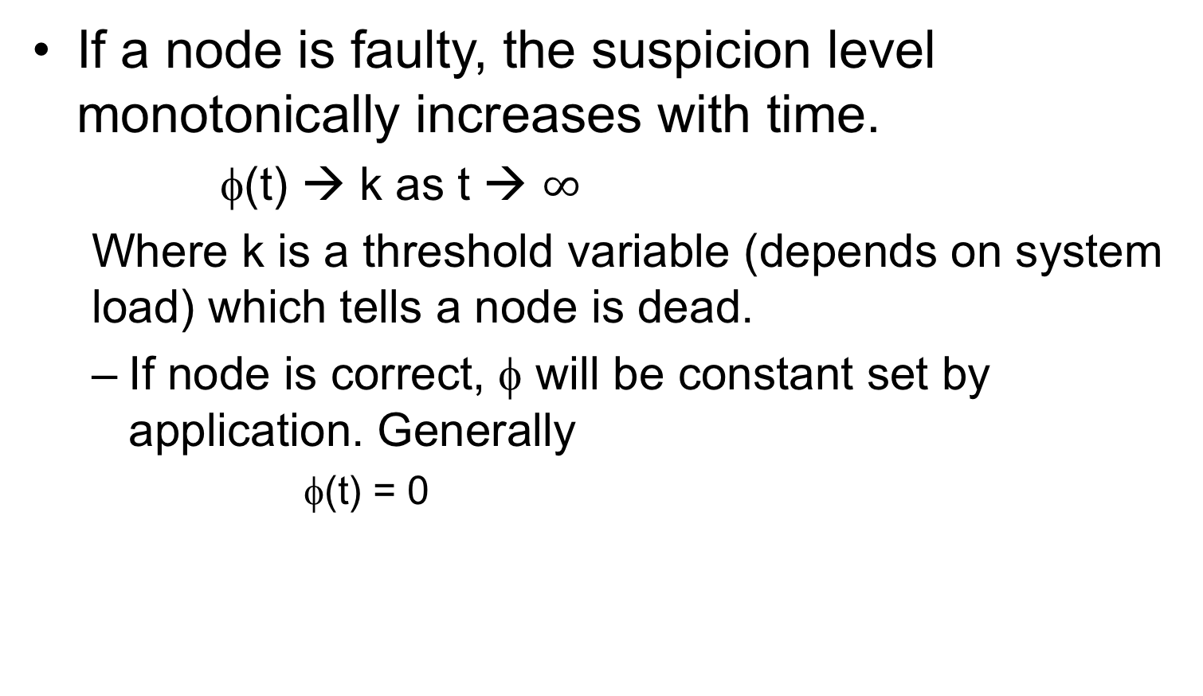
Accrual Failure Detector

Slide 34
Bootstrapping and Scaling
Two ways to add new node
New node gets assigned a random token which gives its position in the ring. It gossips its location to rest of the ring
New node reads its config file to contact its initial contact points.
New nodes are added manually by administrator via CLI or Web interface provided by Cassandra.
Scaling in Cassandra is designed to be easy.
Lightly loaded nodes can move in the ring to alleviate heavily loaded nodes.

Slide 35
Local Persistence
Relies on local file system for data persistence.
Write operations happens in 2 steps
Write to commit log in local disk of the node
Update in-memory data structure.
Why 2 steps or any preference to order of execution?
Read operation
Looks up in-memory data structure first before looking up files on disk.
Uses Bloom Filter (summarization of keys in file store in memory) to avoid looking up files that do not contain the key.

Slide 36
Read Operation
Client
Query
Result
Cassandra Cluster
Read repair if digests differ
Closest replica
Result
Replica A
Digest Query
Digest Response
Digest Response
Replica B
Replica C
Figure taken from Avinash Lakshman and Prashant Malik (authors of the Cassandra paper) slides.

Slide 37
Facebook Inbox Search
Cassandra developed to address this problem
50+TB of user messages data in 150 node cluster on which Cassandra is tested
Search user index of all messages in 2 ways.
Term search: search by a keyword
Interactions search: search by a user id
Latency Stat | Search Interactions | Term Search
Min | 7.69 ms | 7.78 ms
Median | 15.69 ms | 18.27 ms
Max | 26.13 ms | 44.41 ms

Slide 38
Comparison with MySQL
MySQL > 50 GB Data Writes Average : ~300 ms Reads Average : ~350 ms
Cassandra > 50 GB Data Writes Average : 0.12 ms Reads Average : 15 ms
Stats provided by Cassandra paper authors using Facebook data

Slide 39
Comparison using YCSB
Following results taken from ‘Benchmarking Cloud Serving Systems with YCSB’ by Cooper et. al
YCSB is Yahoo Cloud Server Benchmarking framework
Comparison between Cassandra, HBase, PNUTS, and MySQL
Cassandra and HBase have higher read latencies on a read heavy workload than PNUTS and MySQL, and lower update latencies on a write heavy workload.
PNUTS and Cassandra scaled well as the number of servers and workload increased proportionally.

Slide 40
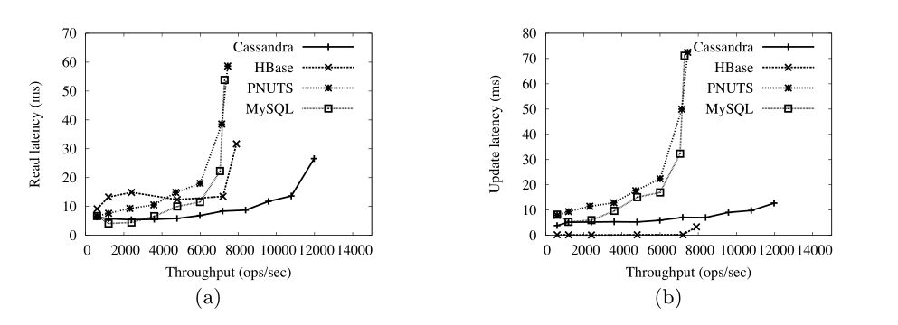
Comparison using YCSB
Cassandra, HBase and PNUTS were able to grow elastically while the workload was executing.
PNUTS and Cassandra scaled well as the number of servers and workload increased proportionally.
Hbase’s performance was more erratic as the system scaled.

Slide 41
UMD DATA605 - Big Data Systems NoSQL systems
Key-value stores Cassandra
HBase

Slide 42
(Apache) HBase
Hadoop DataBase
A distributed, scalable, big data store
Very large tables on clusters of commodity hardware
Uses Hadoop and HDFS
Modeled on Google BigTable

Slide 43
From HDFS to HBase
HDFS provides a filesystem consisting of arbitrarily large files that can only be written once and should be read sequentially, end-to-end.
This works fine for sequential OLAP queries
OLAP = On-Line Analytical Processing
OLTP workloads want to read and write individual cells in a large table
OLTP = On-Line Transactional Processing
E.g., update inventory and price as orders come in
HBase implements OLTP interactions on top of HDFS by using additional storage and memory to organize the tables and writing them back to HDFS as needed

Slide 44
HBase Data Model
A database consists of multiple tables
Each table consists of multiple rows, sorted by row key
Each row contains a row key and one or more column families
Each column family is defined when the table is created
Column families can contain multiple columns (family:column)
A cell is uniquely identified by
(table, row, family:column)
A cell contains an uninterpreted array of bytes and a timestamp

Slide 45
HBase data model in Python
hbase_table = { # Table
'row1': { # Row key
'cf1:col1': 'value1', # Column family, column, and value
'cf1:col2': 'value2',
'cf2:col1': 'value3'
},
'row2': {
… # More row data
}
}
queried_value = hbase_table['row1']['cf1:col1'] # 'value1'

Slide 46
Data in Tabular Form
 | Name |  | Home |  | Office
Key | First | Last | Phone | Email | Phone | Email
101 | Florian | Krepsbach | 555-1212 | florian@ wobegon.org | 666-1212 | fk@phc.com
102 | Marilyn | Tollerud | 555-1213 |  | 666-1213
103 | Pastor | Inqvist |  |  | 555-1214 | inqvist@ wels.org

Slide 47
Data in Tabular Form
Don’t be fooled by the picture: HBase is really a sparse table
 | Name |  |  | Home |  | Office |  | Social
Key | First |  | Last | Phone | Email | Phone | Email | FacebookID
101 | Florian | Garfield | Krepsbach | 555-1212 | florian@ wobegon.org | 666-1212 | fk@phc.com
102 | Marilyn |  | Tollerud | 555-1213 |  | 666-1213
103 | Pastor |  | Inqvist |  |  | 555-1214 | inqvist@ wels.org
New columns can be
added at runtime
Column families cannot be added at runtime

Slide 48
Nested Data Representation
Table People ( Name, Home, Office )
{
101: {
Timestamp: T403;
Name: {First=“Florian”, Middle=“Garfield”, Last=“Krepsbach”},
Home: {Phone=“555-1212”, Email=“florian@wobegon.org”},
Office: {Phone=“666-1212”, Email=“fk@phc.com”}
},
102: {
Timestamp: T593;
Name: { First=“Marilyn”, Last=“Tollerud”},
Home: { Phone=“555-1213” },
Office: { Phone=“666-1213” }
},
…
}

Slide 49
Nested Data Representation
GET People:101
101: {
Timestamp: T403;
Name: {First=“Florian”, Middle=“Garfield”, Last=“Krepsbach”},
Home: {Phone=“555-1212”, Email=“florian@wobegon.org”},
Office: {Phone=“666-1212”, Email=“fk@phc.com”}
}
GET People:101:Name
People:101:Name: {First=“Florian”, Middle=“Garfield”, Last=“Krepsbach”}
GET People:101:Name:First
People:101:Name:First=“Florian”

Slide 50
Fundamental Operations
CREATE table, families
PUT table, rowid, family:column, value
PUT table, rowid, whole-row
GET table, rowid
SCAN table (WITH filters)
DROP table

Slide 51
Consistency Model
Atomicity: Entire rows are updated atomically or not at all
Consistency:
A GET is guaranteed to return a complete row that existed at some point in the table’s history. (Check the timestamp to be sure!)
A SCAN must include all data written prior to the scan, and may include updates since it started.
Isolation: Not guaranteed outside a single row
Durability: All successful writes have been made durable on disk

Slide 52
The Implementation
Here is the idea in several steps:
Idea 1: Put an entire table in one file
It doesn’t work
Idea 2: Log + one file
Better, but doesn’t scale to large data
Idea 3: Log + one file per column family
Getting better!
Idea 4: Partition table into regions by key
Keep in mind that “one file” means one gigantic file stored in HDFS
We don’t have to worry about the details of how the file is split into blocks

Slide 53
Idea 1: Put the Table in a Single File
File “People”
101: {Timestamp: T403; Name: {First=“Florian”, Middle=“Garfield”, Last=“Krepsbach”},Home: {Phone=“555-1212”, Email=“florian@wobegon.org”},Office: {Phone=“666-1212”, Email=“fk@phc.com”}},
102: {Timestamp: T593;Name: { First=“Marilyn”, Last=“Tollerud”},Home: { Phone=“555-1213” },Office: { Phone=“666-1213” }}, . . .
How do we do the following operations?
CREATE
DELETE
SCAN
GET
PUT

Slide 54
Variable-Length Data is Fundamentally Hard!
SQL Table: People( ID: Integer, FirstName: CHAR[20], LastName: Char[20], Phone: CHAR[8] )
UPDATE People SET Phone=“555-3434” WHERE ID=403;
ID FirstName LastName Phone
101 Florian Krepsbach 555-3434
102 Marilyn Tollerud 555-1213
103 Pastor Ingvist 555-1214
Each row is exactly 52 bytes long.
To move to the next row, just fseek(file,+52);
To get to Row 401, fseek(file,401*52);
Overwrite the data in place.
HBase Table People( ID, Name, Home, Office )
PUT People, 403, Home:Phone, 555-3434
101: {Timestamp: T403;Name: {First=“Florian”, Middle=“Garfield”, Last=“Krepsbach”},Home: {Phone=“555-1212”, Email=“florian@wobegon.org”},Office: {Phone=“666-1212”, Email=“fk@phc.com”}},
102: {Timestamp: T593;Name: { First=“Marilyn”, Last=“Tollerud”},Home: { Phone=“555-1213” },Office: { Phone=“666-1213” }}, . . .
?
Fun reading on the topic:
http://www.joelonsoftware.com/articles/fog0000000319.html

Slide 55
Idea 2: One Table + Transaction Log
Table for People
101: {Timestamp: T403;Name: {First=“Florian”, Middle=“Garfield”, Last=“Krepsbach”},Home: {Phone=“555-1212”, Email=“florian@wobegon.org”},Office: {Phone=“666-1212”, Email=“fk@phc.com”}},
102: {Timestamp: T593;Name: { First=“Marilyn”, Last=“Tollerud”},Home: { Phone=“555-1213” },Office: { Phone=“666-1213” }}, . . .
Transaction Log for Table People:
Memory Cache for Table People:
PUT 101:Office:Phone = “555-3434”
PUT 102:Home:Email = mt@yahoo.com
….
101
102
Changes are applied only to the log file,
Then the resulting record is cached in memory.
Reads must consult both memory and disk.
GET People:101
GET People:103
PUT People:101:Office:Phone = “555-3434”

Slide 56
Idea 2 Requires Periodic Log Compression
Table for People on Disk: (Old)
101: {Timestamp: T403;Name: {First=“Florian”, Middle=“Garfield”, Last=“Krepsbach”},Home: {Phone=“555-1212”, Email=“florian@wobegon.org”},Office: {Phone=“666-1212”, Email=“fk@phc.com”}},
102: {Timestamp: T593;Name: { First=“Marilyn”, Last=“Tollerud”},Home: { Phone=“555-1213” },Office: { Phone=“666-1213” }}, . . .
Transaction Log for Table People:
Write out a new copy of the table, with all of the changes applied. Delete the log and memory cache, and start over.
PUT 101:Office:Phone = “555-3434”
PUT 102:Home:Email = mt@yahoo.com
….
Table for People on Disk: (New)
101: {Timestamp: T403;Name: {First=“Florian”, Middle=“Garfield”, Last=“Krepsbach”},Home: {Phone=“555-1212”, Email=“florian@wobegon.org”},Office: {Phone=“555-3434”, Email=“fk@phc.com”}},102: {Timestamp: T593;Name: { First=“Marilyn”, Last=“Tollerud”},Home: { Phone=“555-1213”, Email=“my@yahoo.com” }, . . .

Slide 57
Idea 3: Partition by Column Family
Tablets for People on Disk: (Old)
Data for
Column Family
Name
Data for
Column Family
Home
Data for
Column Family
Office
Transaction Log for Table People:
Write out a new copy of the tablet, with all of the changes applied. Delete the log and memory cache, and start over.
PUT 101:Office:Phone = “555-3434”
PUT 102:Home:Email = mt@yahoo.com
….
Tablets for People on Disk: (New)
Data for
Column Family
Name
Data for
Column Family
Home (Changed)
Data for
Column Family
Office (Changed)

Slide 58
Idea 4: Split Into Regions
Hbase
Client
Access data in tables
(Detail of One Region Server)
Where are the servers for table People?
Region
Server
Region 1: Keys 100-200
Tablet
Column
Family Name
Region
Server
Memory Cache
Region 2: Keys 100-200
Region
Master
Tablet
Column
Family Home
Region
Server
Region 3: Keys 100-200
Transaction Log
Region
Server
Tablet
Column
Family Office
Region 4: Keys 100-200

Slide 59
Column Family Name
Column Family Home
Column Family Office
Region 1
Keys 101-200
Region 2
Keys 201-300
Table People
Region 3
Keys 301-400

Slide 60
The consistency model is tightly coupled to the scalability of the implementation!

Slide 61
Consistency Model
Atomicity: Entire rows are updated atomically or not at all.
Consistency:
A GET is guaranteed to return a complete row that existed at some point in the table’s history. (Check the timestamp to be sure!)
A SCAN must include all data written prior to the scan, and may include updates since it started.
Isolation: Not guaranteed outside a single row.
Durability: All successful writes have been made durable on disk.

